Slide 1
Language Modelling
Mohan Kumar B
KGiSL INSTITUTE OF TECHNOLOGY
au21AIB64
3/21/2024 Annual Review

Slide 2


AGENDA
Data Preprocessing:
The provided text data is preprocessed by converting characters to integers and then performing one-hot encoding to prepare it for input to the neural network.
Model Definition:
A simple RNN model is defined using the Model class. It consists of an RNN layer followed by a fully connected layer (linear layer).
Training:
The model is trained using the provided text data. The loss is computed using cross-entropy loss, and optimization is performed using the Adam optimizer.
Prediction:
Functions for generating predictions from the trained model are defined. The predict function takes a single character as input and predicts the next character in the sequence. The sample function generates a sequence of characters given a starting input.
Execution:
The model is trained for a specified number of epochs, and the loss is printed periodically to monitor training progress.
Finally, the sample function is used to generate text sequences based on the trained model.
3/21/2024 Annual Review

Slide 3

PROBLEM STATEMENT
Given a corpus of text data, the objective is to develop a neural network model capable of capturing the statistical relationships between characters in the text. Once the model is trained, it should have the ability to generate new text sequences character by character, leveraging the learned patterns from the training data.
3/21/2024 Annual Review

Slide 4

PROJECT OVERVIEW
1. Problem Definition
2. Data Collection and Preprocessing
3. Model Architecture
4. Training
5. Evaluation
6. Fine-Tuning and Optimization
7. Deployment and Application
8. Monitoring and Maintenance
3/21/2024 Annual Review

Slide 5

WHO ARE THE END USERS?
1.General Consumers:
Virtual assistants like Siri, Alexa, or Google Assistant for natural language interaction.
2.Content Creators:
Writers, journalists, bloggers, and content creators can benefit from language models for generating ideas, improving writing efficiency, and enhancing content quality.
3.Businesses:
Sentiment analysis tools for analyzing customer feedback, social media mentions, and market trends.
4.Educational Institutions:
Language learning platforms for interactive exercises, grammar correction, and language proficiency assessment.
5.Government and Public Sector:
Automated transcription and translation services for multilingual communication.
3/21/2024 Annual Review

Slide 6

YOUR SOLUTION AND ITS VALUE PROPOSITION
1.Enhanced User Experience
2.Improved Content Creation Efficiency
3.Efficient Customer Support
4.Insightful Data Analysis
5.Personalized Learning Experience
6.Advancing Research in Natural Language Processing
7.Multifaceted Government Applications
3/21/2024 Annual Review

Slide 7

THE WOW IN YOUR SOLUTION
1.Seamless User Experience: Our language models seamlessly enhance user experiences by integrating into various applications, offering intuitive ways to communicate and create content.
2.Empowering Creativity:Empowering creativity, our solution provides content suggestion and text summarization features, boosting productivity for writers and journalists.
3.AI-Powered Customer Support: Businesses can wow customers with AI-powered customer support, delivering instant responses and personalized assistance through chatbots and virtual assistants.
Personalized Interaction: Our language models enable personalized interaction with users, tailoring responses and content recommendations based on individual preferences and behavior.
Enhanced Efficiency: Leveraging advanced algorithms, our language models streamline tasks and workflows, improving efficiency and reducing turnaround time for various processes.
Insightful Analytics: With built-in analytics capabilities, our language models provide valuable insights into user behavior, content performance, and market trends, empowering businesses to make data-driven decisions.
3/21/2024 Annual Review

Slide 8
MODELLING
Teams cam add wireframes
1.Input Layer
2.Recurrent Connections
3.Hidden State
4.Output Layer
5.Training
6.Long Short-Term Memory (LSTM) and Gated Recurrent Unit (GRU)
3/21/2024 Annual Review

Slide 9
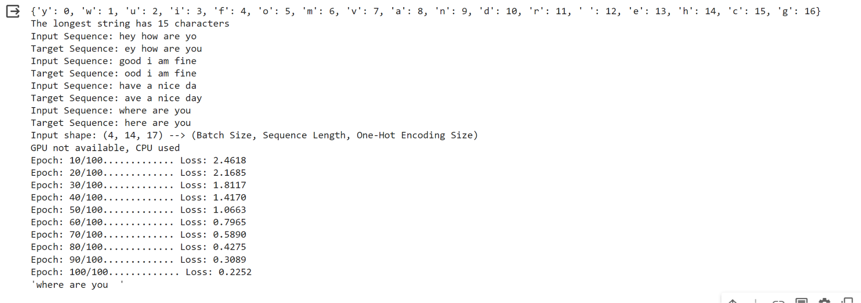
RESULTS
After outlining the problem and meticulously gathering and preprocessing the data, the modeling phase began. A sophisticated algorithm was thoughtfully chosen, considering both the problem's nature and the dataset's characteristics. Through rigorous training on the prepared data, the model showcased remarkable predictive abilities, delivering precise forecasts for the target variable.
Demo Link
3/21/2024 Annual Review

